Slide 1

HTTP 2
Dima Ionut Daniel

Slide 2
Contents
What is HTTP 2?
History
Goals
HTTP 2 features
Architecure
HTTP Methods
SPDY
Multiplexing
Core
Header Compression
HTTP 2 Push
Security
HTTP 1/1 vs HTTP 2.0
Conclusions
Bibliography

Slide 3

What is HTTP 2?
HTTP/2 is the second major version of the HTTP network protocol used by the World Wide Web.
HTTP/2 is based on SPDY.
The HTTP/2 specification was published as RFC 7540 in May 2015.

Slide 4
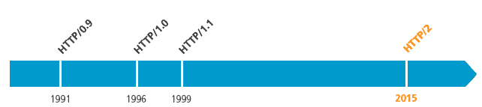
History
The term hypertext was used by Ted Nelson in 1965 in Xanadu project.
The first documented version of HTTP was HTTP v0.9 in 1991.
The HTTP documents were published in December 1995 and the support for pre-standard HTTP 1/1 based on the RFC 2068 were adopted in the 1996.

Slide 5
Goals
Negotiation mechanism that allows clients and servers to select to use HTTP 1.1, 2.0, or other non-HTTP protocols.
Maintain high-level compatibility with HTTP 1.1 (for example with methods, status codes, and URIs, and most header fields)
Decrease latency to improve page load speed in web browsers by considering:
Data compression of HTTP headers
Server push technologies
Pipelining of requests
Fixing the head-of-line blocking problem in HTTP 1.x
Multiplexing multiple requests over a single TCP connection
Support common existing use cases of HTTP, such as desktop web browsers, mobile web browsers, web APIs, web servers at various scales, proxy servers, reverse proxy servers, firewalls, and content delivery networks.

Slide 6
HTTP 2 features
Multiplexing: Multiple asynchronous HTTP requests over a single TCP connection.
Server Push: Multiple responses for single request
Header Compression: Compress HTTP headers along with content.
Request prioritization: While making multiple HTTP requests to a same domain they can be prioritized.
Binary Protocol: HTTP/2 is binary protocol whereas HTTP/1.1 is text protocol.

Slide 7
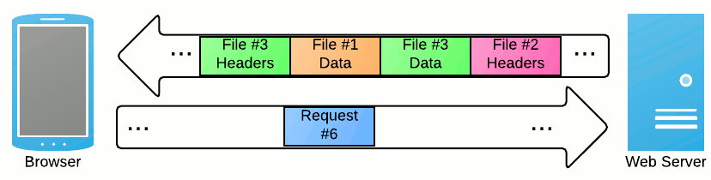
Architecture
HTTP 2 is about using the underlying network connections more efficiently.
HTTP 2 changes how requests and responses travel on the wire.

Slide 8
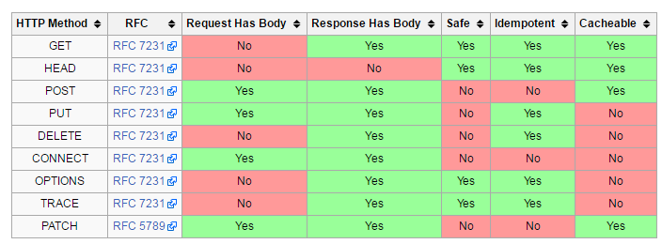
HTTP Methods
HTTP defines methods to indicate the desired action to be performed on the identified resource.
The resource corresponds to a file or the output of an executable residing on the server.
There is no limit to the numbers that can be defined and this allows for future methods.

Slide 9
SPDY
SPDY is an open networking protocol developed primarily at Google for transporting web content.
PDY manipulates HTTP traffic, with particular goals of reducing web page load latency and improving web security.
SPDY achieves reduced latency through compression, multiplexing, and prioritization.
HTTP 2 is built on same foundation as SPDY and replaces it.

Slide 10
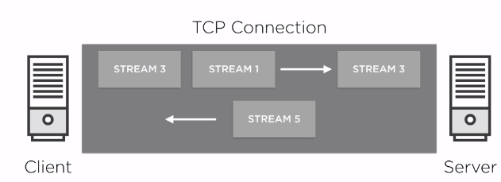
Streams
Stream is a set of frames exchanged.
Multiple streams can be used in parallel.

Slide 11
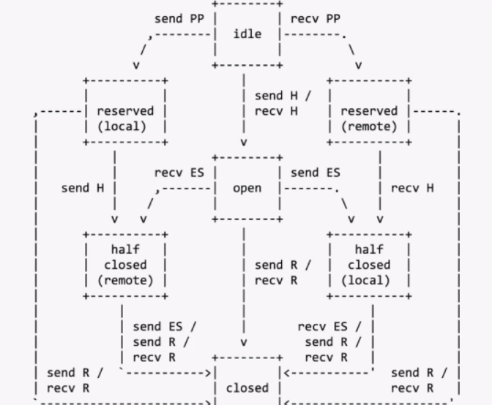
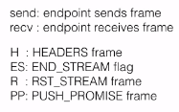
Streams (cont.)
Streams have state.

Slide 12
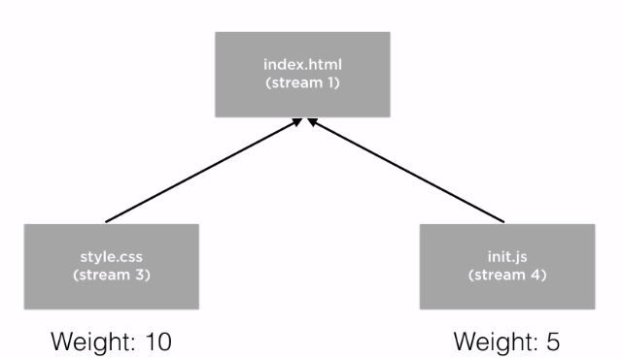
Streams (cont.)
Stream can be prioritized:
Start of exchange using HEADERS frame
Using PRIORITY frame during exchange

Slide 13
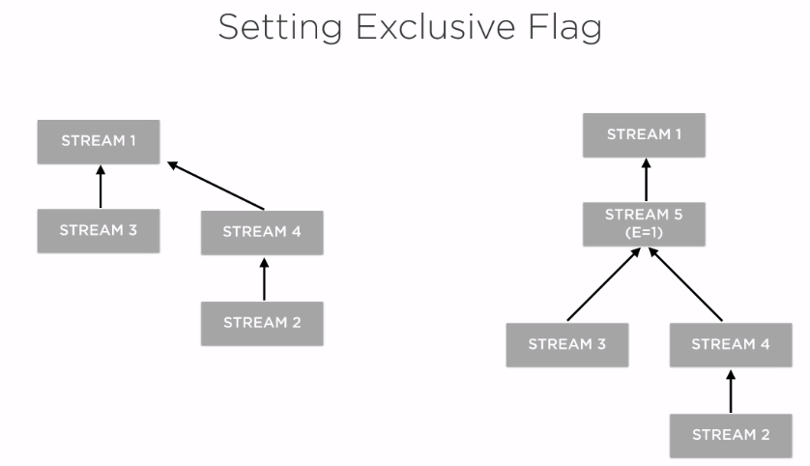
Streams (cont.)

Slide 14
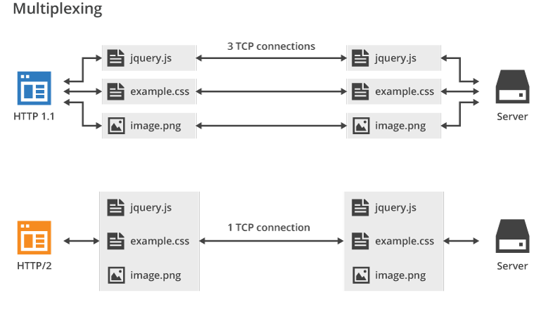
Multiplexing
Multiplexing is a method in HTTP/2 by which multiple HTTP requests can be sent and responses can be received asynchronously via a single TCP connection.
Multiplexing is the heart of HTTP/2 protocol.

Slide 15
Core
HTTP/2 does not obsolete HTTP/1.1's message syntax, and it uses the same URI schemes as HTTP/1.1.
We can use HTTP/1.1 or HTTP/2 over the same default port.
The raw network protocol for HTTP/2 is completely different from the protocol for HTTP 1.1.
HTTP/2 is a binary protocol, multiplexed network protocol.

Slide 16
Core (cont.)
The basic protocol unit of HTTP/2 is a frame.
In HTTP/2, frames are exchanged over a TCP connection instead of text-based messages.
Before being transmitted an HTTP message is split into individual HTTP/2 frames.
HTTP/2 provides different types of frames for different purposes, such as HEADERS, DATA, SETTINGS, or GOAWAY frames.

Slide 17
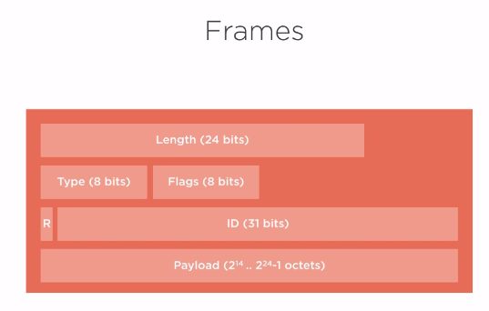
Core (cont.)
Frames packet description:

Slide 18
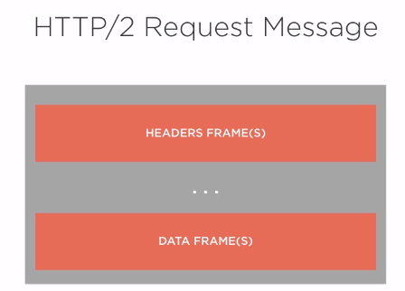
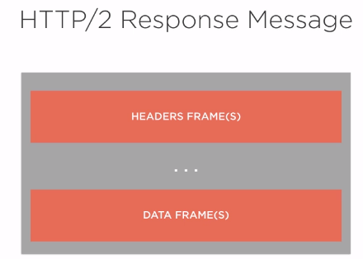
Core (cont.)

Slide 19
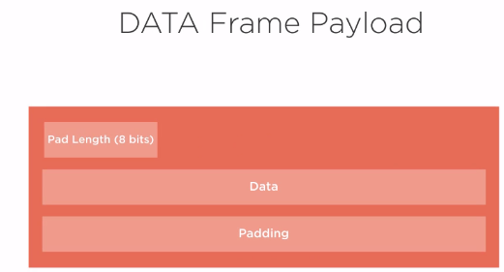
Core (cont.)
DATA frame payload description:
The type is 0x0 and are used to carry HTTP requests and responses payloads.

Slide 20
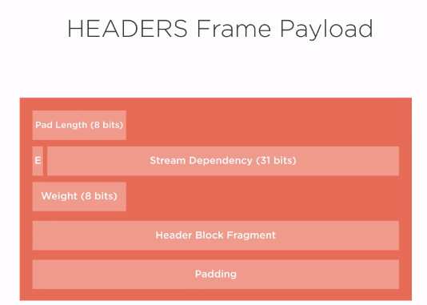
Core (cont.)
HEADERS frame payload description:
The type is 0x1 and is used to open a stream and additionally carry a header block fragment.
HEADERS frames can be sent on a stream in the “idle”, ”reserved(local)”, “open” or “half-closed(remote)” state.

Slide 21
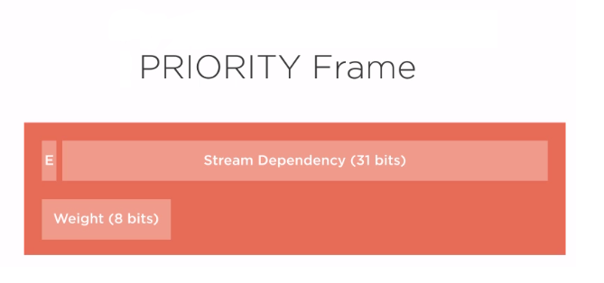
Core (cont.)
PRIORITY frame payload description:
The type is 0x2 and is used to specify streams priority.
It can be sent in any stream state, including idle or closed streams.

Slide 22
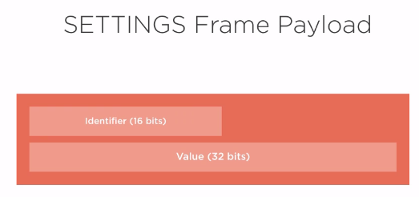
Core (cont.)
SETTINGS frame payload description:
The type is 0x4 and affects how the endpoints communicates

Slide 23
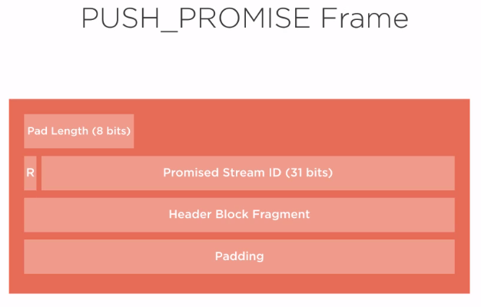
Core (cont.)
PUSH_PROMISE frame payload description:
The type is 0x5 and is used to notify the peer endpoint in advance of streams the sender intends to initiate.

Slide 24
Core (cont.)
SETTINGS_HEADER_TABLE_SIZE (0x1):
Allows the sender to inform the remote endpoint of the maximum size of the header compression table used to decode header blocks, in octets.
SETTINGS_ENABLE_PUSH (0x2):
The Value is 1, which indicates that server push is permitted.
Any value other than 0 or 1 MUST be treated as a connection error of type PROTOCOL_ERROR.
SETTINGS_MAX_CONCURRENT_STREAMS (0x3):
indicates the maximum number of concurrent streams.

Slide 25
Core (cont.)
SETTINGS_INITIAL_WINDOW_SIZE (0x4):
indicates (in octets) the window size for stream-level flow control.
the initial value is 2^16-1 (65,535) octets.
SETTINGS_MAX_FRAME_SIZE (0x5):
Indicates the size of the largest frame payload that the sender is willing to receive, in octets.
The initial value is 2^14 (16,384) octets.
SETTINGS_MAX_HEADER_LIST_SIZE (0x6):
informs a peer of the maximum size of header list that the sender is prepared to accept, in octets.

Slide 26
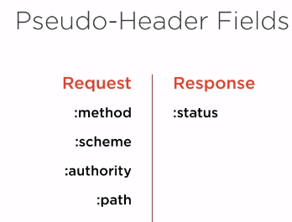
Core (cont.)
Pseudo-Headers appears before the normal headers and offers useful information.

Slide 27
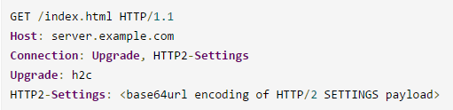
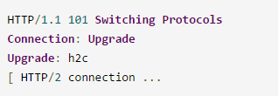
Core (cont.)
When establishing an HTTP connection the server has to know which network protocol to use.
There are two ways to inform the server that it should use HTTP/2:
1)Initiate HTTP/2 protocol response using the HTTP Upgrade header.
An HTTP/2-compatible server would accept the upgrade with a Switching Protocols response.
After the empty line terminating the 101 response, the server would begin sending HTTP/2 frames.

Slide 28
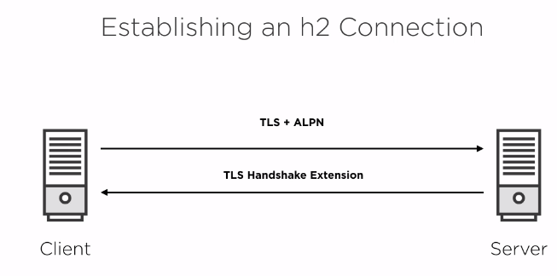
Core (cont.)

Slide 29
Core (cont.)
2)ALPN
For TLS-based connections you could use the Application-Layer Protocol Negotiation (ALPN) extension.
ALPN allows a TLS connection to negotiate which application-level protocol will be running across it.
ALPN is not supported by Java 8.
ALPN support will be coming in Java 9 (see JEP 244)
To use ALPN today you would have to use ALPN libraries that are external to the JDK, like Jetty project.

Slide 30
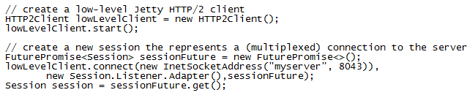
Core (cont.)
After establishing a new HTTP/2 connection each endpoint has to send a connection preface as a final confirmation and to establish the initial settings for the HTTP/2 connection.
The client and the server will send a SETTING frame that includes control data such as the maximum frame size or header-table size.
The HTTP/2 client creates a Session instance that represents the client-side endpoint of an HTTP/2 connection to a server.

Slide 31
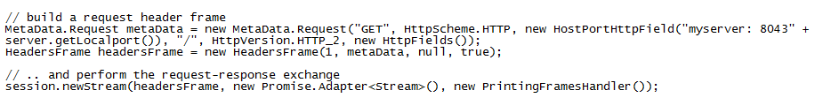
Core (cont.)
Once the HTTP/2 connection has been established, endpoints can begin exchanging frames.
Frames are always associated with a stream.
A single HTTP/2 connection can contain multiple concurrently open streams.
A stream is opened to perform an HTTP request-response exchange.
When the stream is opened a request HEADER frame is provided.

Slide 32
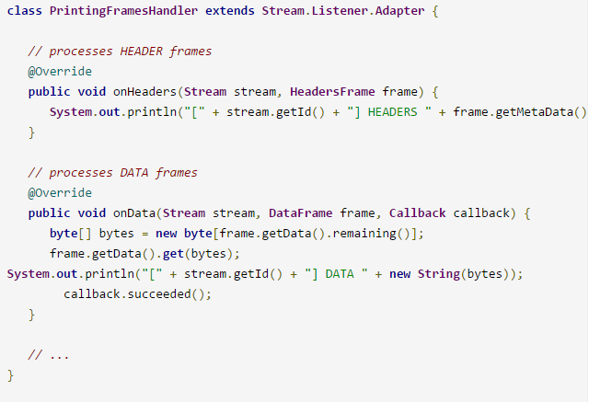
Core (cont.)
To handle the response data a response frame handler has to be assigned to the stream.
The frame handler defines call-back methods to process the different frames types.

Slide 33
Header Compression
HTTP/2 header compression is not like message-body gzip compression.
For every HTTP/2 connection the client and server will maintain a headers table containing the last response and request headers and their values, respectively. Upon the first request or response tall message headers will be sent. But for subsequent messages the endpoints will omit duplicate headers.
In HTTP/2 a request-response exchange becomes cheap.

Slide 34
Header Compression (cont.)
HTTP/2 header compression is based on HPACK.
HPACK is defined under RFC 7541 (https://tools.ietf.org/html/rfc7541).
HPACK uses two tables for associating header fields to indexes.
The static table is predefined and contains common header field.s
The dynamic table is dynamic and can be used by the encoder to index header fields repeated in the encoded header lists.

Slide 35
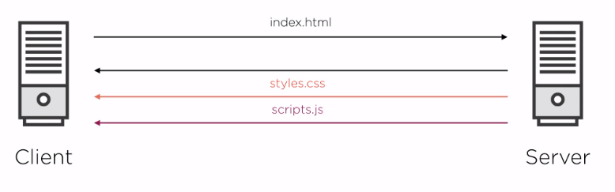
HTTP 2 Push
HTTP/2 push allows a server to proactively send resources to the client's cache for future use.

Slide 36
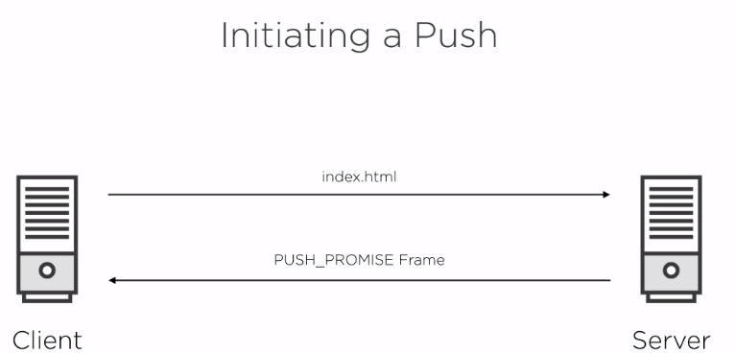
HTTP 2 Push (cont.)

Slide 37
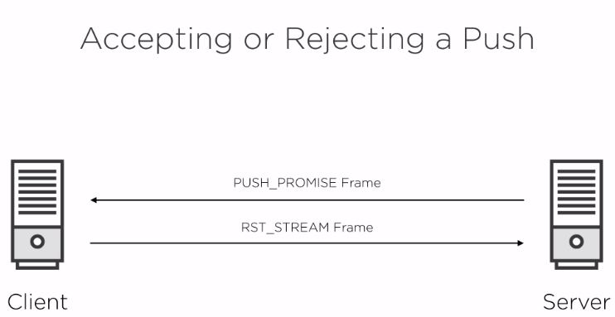
HTTP 2 Push (cont.)

Slide 38
HTTP 2 Push (cont.)
HTTP 2 PUSH requirements:
Cacheable
Safe
Does not include a body request
Option SETTING_ENABLE_PUSH set to true

Slide 39
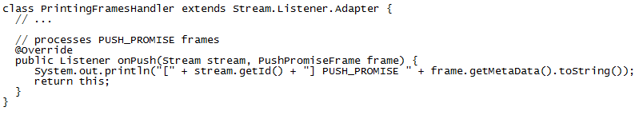
HTTP 2 Push (cont.)
HTTP/2 push is not intended to replace server-sent events or WebSockets, which were introduced with HTML5.
Server-sent events and WebSockets allow the server to send events or data at any time without a preceding HTTP request.
A PUSH_PROMISE frame includes the associated HTTP request message data for the pushed HTTP response message.

Slide 40
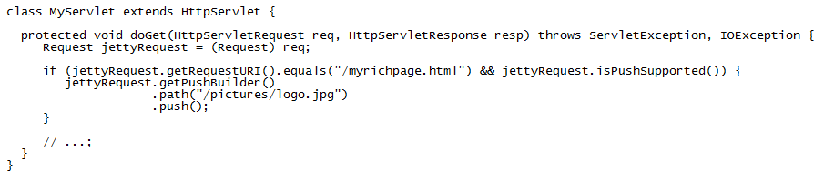
HTTP 2 Push(cont.)
Jetty's push support to generate PUSH_PROMISE frames on the server-side.
Jetty's http2-server module provides a PushBuilder to initiate a push promise.
The resource addressed by the URI path /pictures/logo.jpg will be pushed to the server if the /myrichpage.html page is requested.

Slide 41
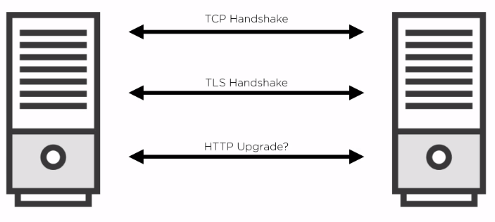
Security
TLS (Transport Layer Security) is the successor to SSL3.
TLS provides:
Encryption
Authentication
Integrity

Slide 42
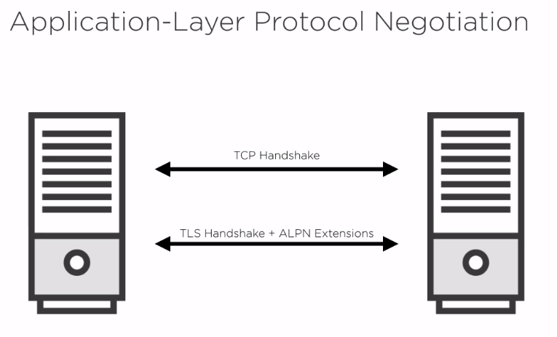
Security (cont.)

Slide 43
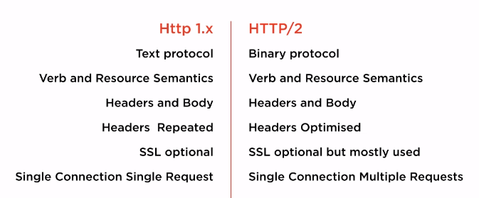
HTTP 1.1 vs HTTP 2

Slide 44
Conclusions
Pros:
Faster page loads
Secure Push
Real connections

Slide 45

Bibliography
https://en.wikipedia.org/wiki/HTTP/2
http://qnimate.com/post-series/http2-complete-tutorial/
http://www.javaworld.com/article/2916548/java-web-development/http-2-for-java-developers.html
https://blog.cloudflare.com/http-2-for-web-developers/
https://en.wikipedia.org/wiki/SPDY
https://tools.ietf.org/html/rfc7540
https://http2.github.io/http2-spec/compression.html
Pluralsight – HTTP 2 Fundamentals

